Slide 1
YouTube Data Analysis Using Excel & Tableau

Slide 2
Objective:
To analyze YouTube video performance by views and likes across days and months.

Slide 3
Dataset Info:
Source of data-Youtube Channel(Think School)
Total videos analyzed-50
Field used-Title,Upload Date,Views,Likes,Day

Slide 4
Tools Used:
Microsoft Excel
Tableau Public

Slide 5
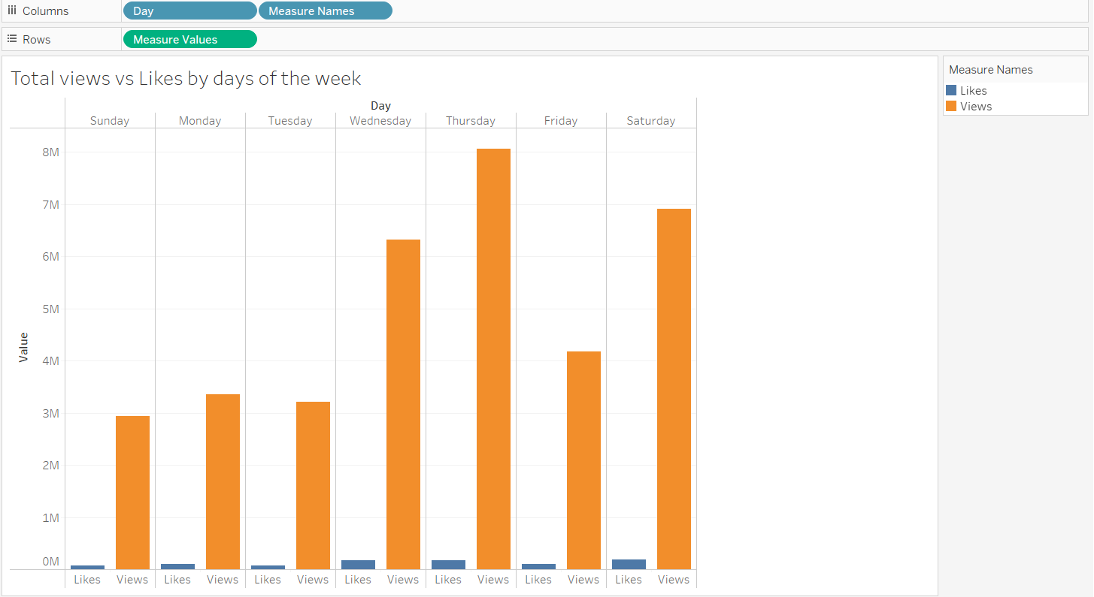
Visualization-Day-wise

Slide 6
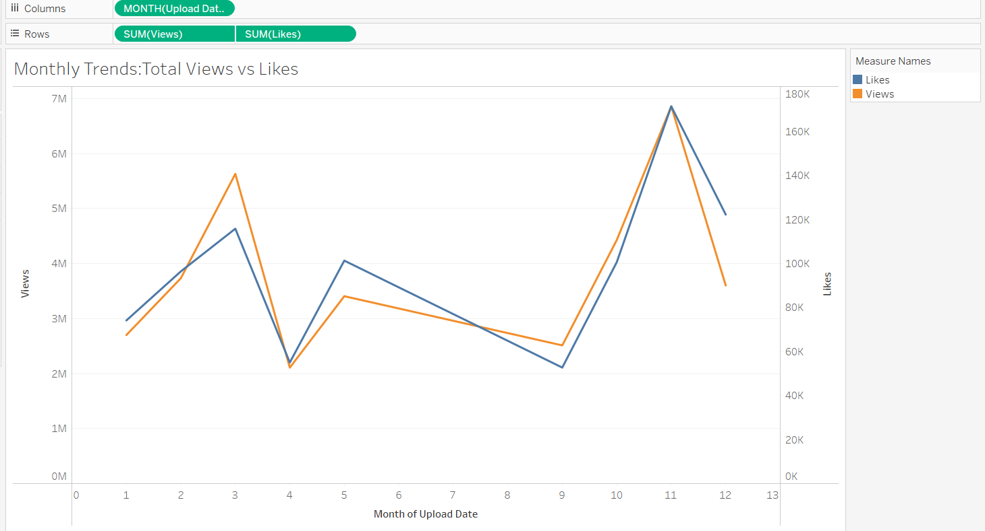
Visualization-Month-wise

Slide 7
Key Insights:
Day-wise-Trends(Views vs Likes):
Thursday had the highest number of views, making it the best day for engagement.
Wednesday and Saturday also performed well in total views.
Sunday to Tuesday saw lower view counts, indicating less audience activity.
Likes remain low and consistent across all days,suggesting limited active engagement.

Slide 8
Month-wise-Trends(Views vs Likes):
November had the highest views and likes,showing peak performance.
March also saw a significant rise in views.
April and August had noticeable drops in both views and likes.
A strong upward trend was seen from September to November, showing improved engagement.

Slide 9
Conclusion
Thursday is the best day for maximizing views on YouTube content.
November had the highest number of views and likes, making it the most engaging month.
Viewer engagement(likes) is fairly consistent across days, but can be improved with better interaction strategies.
Uploading more content from September to November may lead to higher engagement based on trend patterns.

Slide 10
Thank you

